Slide 1

AGENDA
Extreme Gradient Boosting.
Theory and Application on the Students’ Dropout and Academic Succes Dataset
1. INTRODUCTION
2. THEORY FRAMEWORK
Application of EDM methods to understand and improve educational systems
APPLICATION OF M.L. ALGORITHMS
3.1 DATASET
Dissertation by: Lorenzo Bonatti
Supervisor: Alessia Pini
3.2 PREDICTION
3.3 «PRE-ENROLLMENT» ANALYSIS
4. CONCLUSION
Academic Year 2023/2024

Slide 2
AGENDA
Extreme Gradient Boosting. Theory and Application on the Students’ Dropout and Academic Succes Dataset
1. INTRODUCTION
2. THEORY FRAMEWORK
APPLICATION OF M.L. ALGORITHMS
Application of EDM methods to understand and improve educational systems
Dissertation by: Alessandro Scarpato
3.1 DATASET
Supervisor: Andrea Pozzi
3.2 PREDICTION
3.3 «PRE-ENROLLMENT» ANALYSIS
4. CONCLUSION
Academic Year 2023/2024

Slide 3
INTRODUCTION
Main context
“Understanding student success requires more than intuition, it demands data, models, and analytics.”
Most of these data remains hidden or unused
Importance of highlight those data and visualize them
Interactive dashboards as a crucial tool for this scope

Slide 4
INTRODUCTION
The Unexpected Reach of Machine Learning: EDM
“Understanding student success requires more than intuition, it demands data, models, and analytics.”
Machine learning applications can extend beyond traditional fields like finance, e-commerce, logistics, and healthcare
Educational Data Mining (EDM): is the data-driven
methods to understand and improve educational systems.
In education, it unlocks insights into the factors
influencing student success and failure.

Slide 5


APPLICATION OF M.L. ALGORITHMS
Intermediary Role: Facilitates communication between the Presentation and Data Layers.
Predictions
Algorithm used:
CARTS
BAGGING
RANDOM FORREST
GRADIENT BOOSTING
EXTREME GRADIENT BOOSTING (XGBOOST)
Serves as a baseline

Slide 6





THEORY FRAMEWORK
Extreme Gradient Boosting (XGBoost)
The key innovation of XGBoost is the introduction of a regularization term.
patient personal data
Physicians
Indeed, the new objective function consists of two components:
Economic performance
Regularization Term
Appointment management
Prescriptions and diagnoses
The purpose of this term is to prevent overfitting by penalizing tree complexity.
Training Loss: measures how well the model fits the training data

Slide 7
THEORY FRAMEWORK
Extreme Gradient Boosting (XGBoost)
The key innovation of XGBoost is the introduction of a regularization term.
patient personal data
Physicians
Indeed, the new objective function consists of two components:
Economic performance
Regularization Term
Appointment management
Prescriptions and diagnoses
The purpose of this term is to prevent overfitting by penalizing tree complexity.
Training Loss: measures how well the model fits the training data

Slide 8
THEORY FRAMEWORK
Extreme Gradient Boosting (XGBoost)
Indeed, the new objective function consists of two components:
patient personal data
Physicians
Economic performance
Regularization Term
Training Loss: measures how well the model fits the training data
Appointment management
Prescriptions and diagnoses
The purpose of this term is to prevent overfitting by penalizing tree complexity.

Slide 9

THEORY FRAMEWORK
Extreme Gradient Boosting (XGBoost)
New objective function made of two components:
patient personal data
How XGBoost builds the tree in the ensemble ?
Physicians
Economic performance
Training Loss
Regularization Term
Appointment management
Prescriptions and diagnoses
The purpose of this term is to prevent overfitting by penalizing tree complexity.

Slide 10
THEORY FRAMEWORK
Extreme Gradient Boosting (XGBoost)
patient personal data
How XGBoost builds the tree in the ensemble ?
Physicians
Economic performance
Appointment management
Prescriptions and diagnoses
We optimize the objective function with respect to the leaf weights

Slide 11


THEORY FRAMEWORK
Extreme Gradient Boosting
patient personal data
How XGBoost builds the tree in the ensemble ?
We optimize the previous objective function with respect to the leaf weights…
Physicians
Economic performance
This last equation measures how good the tree structure is !
Appointment management
Prescriptions and diagnoses

Slide 12
THEORY FRAMEWORK
Extreme Gradient Boosting
patient personal data
How XGBoost builds the tree in the ensemble ?
We optimize the previous objective function with respect to the leaf weights…
Physicians
Economic performance
This last equation measures how good the tree structure is !
Appointment management
Prescriptions and diagnoses

Slide 13


THEORY FRAMEWORK
Extreme Gradient Boosting
patient personal data
How XGBoost builds the tree in the ensemble ?
Ideally, we should enumerate all possible trees and pick the one that has the lowest objective value.
Physicians
Economic performance
But in practice this is not feasible !
Appointment management
Instead of attempting to build the entire tree all at once, the model focuses on improving the tree structure step by step.
Prescriptions and diagnoses

Slide 14

THEORY FRAMEWORK
Extreme Gradient Boosting
How XGBoost builds the tree in the ensemble ?
Ideally, we should enumerate all possible trees and pick the one that has the lowest objective value.
But in practice this is not feasible !
Instead of attempting to build the entire tree all at once, XGBoost focuses on improving the tree structure step by step.
Because the possible number of trees grows exponentially with the increase of the tree depth and the number of variables

Slide 15

THEORY FRAMEWORK
Extreme Gradient Boosting
How XGBoost builds the tree in the ensemble ?
Ideally, we should enumerate all possible trees and pick the one that has the lowest objective value.
Instead of attempting to build the entire tree all at once, XGBoost focuses on improving the tree structure step by step.
More specifically, the process involves taking an existing leaf of the tree and attempt in to split it into two leaves and so on…

Slide 16
THEORY FRAMEWORK
Extreme Gradient Boosting
How XGBoost builds the tree in the ensemble ?
Instead of attempting to build the entire tree all at once, XGBoost focuses on improving the tree structure step by step.
More specifically, the process involves taking an existing leaf of the tree and attempt to split it into two leaves and so on...

Slide 17
THEORY FRAMEWORK
Extreme Gradient Boosting: Visualization
We start with a tree with one single leaf with all the residuals
Try for example to split the residuals with X < 15
0.5, - 05, 0.5, -0.5
The 3 residuals with X < 15 goes to the left leaf..
The only residuals with X > 15 goes to the right leaf…

Slide 18
THEORY FRAMEWORK
Extreme Gradient Boosting
Try for example to split the residuals with X < 15
0.5, - 05, 0.5, -0.5
The 3 residuals with X < 15 goes to the left leaf..
The only residuals with X > 15 goes to the right leaf…
Now, we have to decide if we can improve our tree by splitting the root node and clustering similar residuals

Slide 19
THEORY FRAMEWORK
Extreme Gradient Boosting
We try for example to split the residuals with X < 15
0.5, - 05, 0.5, -0.5
The 3 residuals with X < 15 goes to the left leaf..
The only residuals with X > 15 goes to the right leaf…
We compute the similarity score for each leaf, this score is telling us how much homogeneous are the residuals in that leaf

Slide 20
THEORY FRAMEWORK
Extreme Gradient Boosting
Try for example to split the residuals with X < 15
X < 15
The 3 residuals with X < 15 goes to the left leaf..
-0.5, 0.5, 05
-0.5
The only residuals with X > 15 goes to the right leaf…
We compute the similarity score for each leaf: this score is telling us how much homogeneous are the residuals in that leaf

Slide 21
THEORY FRAMEWORK
Extreme Gradient Boosting
Try for example to split the residuals with X < 15
X < 15
The 3 residuals with X < 15 goes to the left leaf..
-0.5, 0.5, 05
-0.5
The only residuals with X > 15 goes to the right leaf…
We compute the similarity score for each leaf: this score is telling us how much homogeneous are the residuals in that leaf

Slide 22
THEORY FRAMEWORK
Extreme Gradient Boosting
X < 15
Similarity Root = 0
Similarity Left Leaf = 0.33
-0.5, 0.5, 05
-0.5
Similarity Right Leaf = 1
Compute the gain associated with X <15 split
Gain = Sim. Left + Sim. Right – Sim. Root
Gain = 0.33 + 1 – 0 = 1.33

Slide 23
THEORY FRAMEWORK
Extreme Gradient Boosting
X < 15
Similarity root = 0
Similarity left leaf = 0.33
-0.5, 0.5, 05
-0.5
Similarity right leaf = 1
Compute the gain associated with X <15 split
Gain = Sim. Left + Sim. Right – Sim. Root
Gain = 0.33 + 1 – 0 = 1.33

Slide 24
THEORY FRAMEWORK
Extreme Gradient Boosting
X < 15
Similarity root = 0
Similarity left leaf = 0.33
-0.5, 0.5, 05
-0.5
Similarity right leaf = 1
Compute the gain associated with X <15 split
Gain = Sim. Left + Sim. Right – Sim. Root
Gain = 0.33 + 1 – 0 = 1.33
Compute the gain scores for all possible residual splits, such as X < 10, X < 5, ect.

Slide 25

THEORY FRAMEWORK
Extreme Gradient Boosting
X < 15
Similarity root = 0
Similarity left leaf = 0.33
-0.5, 0.5, 05
-0.5
Similarity right leaf = 1
If Gain = 1.33 is the highest among all possible splits,
we keep it and …
Compute the gain associated with X <15 split
Gain = Sim. Left + Sim. Right – Sim. Root
Gain = 0.33 + 1 – 0 = 1.33
Compute the gain scores for all possible residual splits, such as X < 10, X < 5, ect.
Compare it with the treshold Gamma

Slide 26
THEORY FRAMEWORK
Extreme Gradient Boosting
X < 15
Similarity root = 0
Similarity left leaf = 0.33
-0.5, 0.5, 05
-0.5
Similarity right leaf = 1
If Gain = 1.33 is the highest among all possible splits,
we keep it and …
If Gain > Gamma, the improvement in the tree structure is significant.
Compare it with the treshold Gamma

Slide 27
THEORY FRAMEWORK
Extreme Gradient Boosting
X < 15
Similarity root = 0
Similarity left leaf = 0.33
-0.5, 0.5, 05
-0.5
Similarity right leaf = 1
If Gain > Gamma, the improvement in the tree structure is significant.
We compare it with the treshold Gamma
Gain = 0.33 + 1 – 0 = 1.33

Slide 28

THEORY FRAMEWORK
Extreme Gradient Boosting
X < 15
Similarity root = 0
Similarity left leaf = 0.33
-0.5, 0.5, 05
-0.5
Similarity right leaf = 1
If Gain > Gamma
The split is made !
If Gain < Gamma, the improvement in the tree structure is not significant

Slide 29

THEORY FRAMEWORK
Extreme Gradient Boosting
X < 15
Similarity root = 0
Similarity left leaf = 0.33
-0.5, 0.5, 05
-0.5
Similarity right leaf = 1
If Gain > Gamma
The split is made !
If Gain < Gamma, the improvement in the tree structure is not significant
The split is not made !

Slide 30
THEORY FRAMEWORK
Extreme Gradient Boosting
X < 15
Similarity root = 0
Similarity left leaf = 0.33
-0.5, 0.5, 05
-0.5
Similarity right leaf = 1
Gain = 1.33 > Gamma = 1
If Gain > Gamma
The split is made !
If Gain < Gamma
The split is not made !

Slide 31
THEORY FRAMEWORK
Extreme Gradient Boosting
X < 15
Similarity root = 0
Similarity left leaf = 0.33
-0.5, 0.5, 05
-0.5
Similarity right leaf = 1
Gain = 1.33 > Gamma = 1
We split the root at X < 15 and keep the above tree structure

Slide 32
THEORY FRAMEWORK
Extreme Gradient Boosting
X < 15
Similarity root = 0
Similarity left leaf = 0.33
-0.5, 0.5, 05
-0.5
Similarity right leaf = 1
Gain = 1.33 > Gamma = 1
We split the root at X < 15 and keep the above tree structure

Slide 33
THEORY FRAMEWORK
Extreme Gradient Boosting
X < 15
Focus on the left leave
And try to split these residuals in two leafs !
-0.5, 0.5, 05
-0.5
We split the root at X < 15 and keep the above tree structure

Slide 34
THEORY FRAMEWORK
Extreme Gradient Boosting
X < 15
Focus on the left leave
Now we try to split these residuals in two leafs !
-0.5, 0.5, 05
-0.5
We try treshold X < 5
We split the root at X < 15 and keep the above tree structure

Slide 35
THEORY FRAMEWORK
Extreme Gradient Boosting
We compute the similarity score
X < 15
Sim. Root = 0.33
X < 5
-0.5
-0.5
0.5, 0.5
Sim. Left Leaf = 1
Sim. Right Leaf = 2
We split the root at X < 15 and keep the above tree structure

Slide 36
THEORY FRAMEWORK
Extreme Gradient Boosting
We compute the gain
X < 15
Sim. Root = 0.33
X < 5
-0.5
-0.5
0.5, 0.5
Sim. Right Leaf = 2
Sim. Left Leaf = 1
We split the root at X < 15 and keep the above tree structure
Gain = 1 + 2 – 0.33 = 2.66

Slide 37
THEORY FRAMEWORK
Extreme Gradient Boosting
Before moving on, we test another split: X < 10
X < 15
Tree structure changes!
X < 10
-0.5
-0.5, 0.5
0.5

Slide 38
THEORY FRAMEWORK
Extreme Gradient Boosting
Try another split: X < 10
X < 15
Tree structure is changing !
Sim. Root = 0.33
X < 10
-0.5
Sim. Left leave= 0
-0.5, 0.5
0.5
Sim. Right leave = 1

Slide 39
THEORY FRAMEWORK
Extreme Gradient Boosting
Try another split: X < 10
X < 15
Tree structure is changing !
Sim. Root = 0.33
X < 10
-0.5
Sim. Left leave= 0
-0.5, 0.5
0.5
Sim. Right leave = 1
Gain = 0 + 1 – 0.33 = 0.77
< Gain = 2.66

Slide 40
THEORY FRAMEWORK
Extreme Gradient Boosting
Try another split: X < 10
X < 15
Tree structure is changing !
Sim. Root = 0.33
X < 10
-0.5
Sim. Left leave= 0
-0.5, 0.5
0.5
Sim. Right leave = 1
Gain = 0 + 1 – 0.33 = 0.77
< Gain = 2.66
X < 5 split works better !

Slide 41
THEORY FRAMEWORK
Extreme Gradient Boosting
Try another split: X < 10
Back to the previous tree structure
X < 15
Tree structure is changing !
Sim. Root = 0.33
X < 10
-0.5
Sim. Left leave= 0
-0.5, 0.5
0.5
Sim. Right leave = 1
Is the improvement significant ?
Gain = 0 + 1 – 0.33 = 0.77
< Gain = 2.66
X < 5 split works better !

Slide 42
THEORY FRAMEWORK
Extreme Gradient Boosting
Back to the previous tree structure
X < 15
X < 5
-0.5
-0.5
0.5, 0.5
Is the improvement significant ?
Gain = 2.66

Slide 43
THEORY FRAMEWORK
Extreme Gradient Boosting
Back to the previous tree structure
X < 15
Split X < 5 is made !
X < 5
-0.5
-0.5
0.5, 0.5
Is the improvement significant ?
Gain = 2.66 > Gamma = 1

Slide 44
THEORY FRAMEWORK
Extreme Gradient Boosting
Back to the previous tree structure
X < 15
Split X < 5 is made !
X < 5
-0.5
-0.5
0.5, 0.5
Is the improvement significant ?
Gain = 2.66 > Gamma = 1

Slide 45
THEORY FRAMEWORK
Extreme Gradient Boosting
X < 15
X < 5
-0.5
-0.5
0.5, 0.5
We then continue and focus of how we can split this leave into two new leaves ….
Gain = 2.66

Slide 46





APPLICATION OF M.L. ALGORITHMS
Dataset
Dataset
Subject area: Education
Number of instances: 4424
Real
Number of features: 36
Categorical
Target Variable.
Integer
Initial commit
Merge
Master
(the main branch)
Navbar
(the feature branch)
Add navbar

Slide 47



DASHBOARD
project schema
Dataset
Subject area: Education
Number of instances: 4424
Real
Number of features: 36
Categorical
Graduate
50%
Target Variable
Integer
Enrolled
18%
Dropout
32%
Final status of the student at the end of their university studies.

Slide 48
DASHBOARD
project schema
Dataset
Subject area: Education
Number of instances: 4424
Graduate
50%
Number of features: 36
Enrolled
18%
Target Variable
Dropout
32%
Final status of the students at the end of their university studies.
Imbalanced response classes !

Slide 49
DASHBOARD
project schema
Dataset
Subject area: Education
Number of instances: 4424
Graduate
51%
Number of features: 36
Enrolled
17%
Target Variable
Dropout
32%
Final status of the students at the end of their university studies.
Imbalanced response classes !

Slide 50


APPLICATION OF M.L. ALGORITHMS
Intermediary Role: Facilitates communication between the Presentation and Data Layers.
EXPERIMENTS WORKFLOW
DATASET
3-CLASS ANALYSIS
2-CLASS ANALYSIS
IMPROVE PREDICTION PERFORMANCE
BEST MODEL SELECTION
PRE-ENROLLEMNET ANALYSIS
3-CLASS ANALYSIS
SOLVING CLASS IMBALANCE PROBLEM
2-CLASS ANALYSIS

Slide 51
DATASET AND PREPROCESSING
New Target variable in Two-Class Analysis
Target variable: Final status of the student at the end of their university studies.
patient personal data
Success
51%
Graduate
Physicians
Two-classes
Dropout
32%
Economic performance
Failed
49%
Appointment management
Enrolled
17%
Prescriptions and diagnoses
No more imbalanced target variable classes !

Slide 52
APPLICATION OF M.L. ALGORITHMS
Intermediary Role: Facilitates communication between the Presentation and Data Layers.
EXPERIMENTS WORKFLOW
DATASET
3-CLASS ANALYSIS
2-CLASS ANALYSIS
IMPROVE PREDICTION PERFORMANCE
BEST MODEL SELECTION
PRE-ENROLLEMNET ANALYSIS
3-CLASS ANALYSIS
SOLVING CLASS IMBALANCE PROBLEM
2-CLASS ANALYSIS

Slide 53







APPLICATION OF M.L. ALGORITHM,
Features overview
Dataset
1. Gender
2. Nationality
4. Debtor
3. Age at enrollment
Demografic
5. Tuition fees up-to-date
6. Scholarship holder
7. Displaced
Socio-economic status
8. Mother’s qualification
9. Father’s qualification
10. Mother’s occupation
Family background
11. Father’s occupation
12. First semester grade
13. Total number of curr. units approved
14. Total number of curr. units enrolled
Academic performance
15. Second semester grade
16. Course
Academic pathway
17. Attendance
18. Application mode
19. Unemployment rate
20. Inflation rate
Regional Macroeconomic context
21. GDP

Slide 54


APPLICATION OF M.L. ALGORITHMS
Intermediary Role: Facilitates communication between the Presentation and Data Layers.
Predictions
ALGORITHM USED:
CARTS
BAGGING
RANDOM FORREST
EXTREME GRADIENT BOOSTING (XGBOOST)
Serves as a baseline

Slide 55


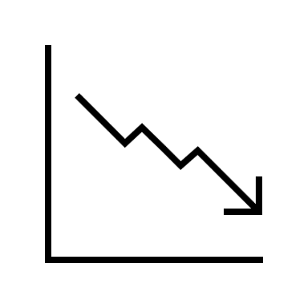





PREDICTION
Parameter tunning
XGBoost parameters
Max delta step
Main problem: we have a total number of 9 parameters to test, each one of them with at least 5 different values
Learning rate
Max tree depth
Min child weight
Gamma
Subsample
Colsample by tree
Lambda
Alpha

Slide 56
PREDICTION
Parameter tunning
XGBoost parameters
Max delta step
Main problem: we have a total number of 9 parameters to test, each one of them with at least 5 different values
Learning rate
Max tree depth
Min child weight
5⁹
= 1.953.125 possible combinations !
Gamma
Subsample
We tuned the parameters following a step-by-step process, adjusting one parameter at a time.
Colsample by tree
Lambda
Alpha

Slide 57

PREDICTION
Parameter tunning
XGBoost parameters
Max delta step
Main problem: we have a total number of 9 parameters to test, each one of them with at least 5 different values
Learning rate
Max tree depth
Min child weight
5⁹
= 1.953.125 possible combinations !
Gamma
Subsample
We tuned the parameters following a step-by-step process, adjusting one parameter at a time.
Colsample by tree
Lambda
Alpha

Slide 58
PREDICTION
Parameter tunning
XGBoost parameters
Max delta step
Main problem: we have a total number of 9 parameters to test, each one of them with a least 5 different values
Learning rate
Max tree depth
Min child weight
5⁹
= 1.953.125 possible combinations !
Gamma
Subsample
We tuned the parameters following a step-by-step process, adjusting one parameter at a time.
Colsample by tree
Lambda
Alpha

Slide 59

APPLICATION OF M.L. ALGORITHMS
Step-wise tuning strategy
1. Start the initial default values
2. Tune number of boosting rounds
That is also the number of tree used in the ensemble

Slide 60
APPLICATION OF M.L. ALGORITHMS
Stepwise tuning procedure
1. Start the initial default values
2. Tune number of boosting rounds
That is also the number of tree used in the ensemble
3. Max Tree depth ; Min child weight
This parameters define the complexity of the tree structure

Slide 61
APPLICATION OF M.L. ALGORITHMS
Stepwise tuning procedure
1. Start the initial default values
2. Tune number of boosting rounds
3. Max Tree depth ; Min child weight
This parameters define the complexity of the tree structure
4. Gamma
This parmeter represent the Minimum gain necessary for a split to occur: if the gain is above this threshold the split is made!
It acts like a shield against a too
complex tree structure

Slide 62
APPLICATION OF M.L. ALGORITHMS
Step-wise tuning strategy
1. Start the initial default values
2. Tune number of boosting rounds
3. Max Tree depth ; Min child weight
4. Gamma
represent the Minimum gain necessary for a split to occur: if the gain is above this threshold the split is made!
It acts like a shield against a too
complex tree structure
5. Subsample ; Colsample by tree
The first one introduces randomness by sampling a percentage of rows before building each tree
The second one introduces randomness by selecting a subset of features before growing each tree, promoting feature diversity

Slide 63
APPLICATION OF M.L. ALGORITHMS
Step-wise tuning strategy
1. Start the initial default values
2. Tune number of boosting rounds
3. Max Tree depth ; Min child weight
4. Gamma
The first one introduces randomness by sampling a percentage of rows before building each tree
The second one introduces randomness by selecting a subset of features before growing each tree, promoting feature diversity
5. Subsample ; Colsample by tree
Are the regularization parameters that help in preventing overfitting
6. Lambda ; Alpha

Slide 64
APPLICATION OF M.L. ALGORITHMS
Step-wise tuning strategy
1. Start the initial default values
2. Number of boosting rounds
3. Max Tree depth ; Min child weight
4. Gamma
5. Subsample ; Colsample by tree
Are the regularization parameters that help in preventing overfitting
6. Lambda ; Alpha
7. Learning rate (eta)
controls the step size at each iteration during the optimization process.

Slide 65
APPLICATION OF M.L. ALGORITHMS
Step-wise tuning strategy
1. Start the initial default values
2. Tune number of boosting rounds
3. Max Tree depth ; Min child weight
4. Gamma
5. Subsample ; Colsample by tree
6. Lambda ; Alpha
controls the step size at each iteration during the optimization process.
7. Learning rate (eta)
8. Max delta step

Slide 66
APPLICATION OF M.L. ALGORITHMS
Step-wise tuning strategy
Start the initial default values
Number of boosting rounds
Max tree depth ; Min child weight
Gamma
Subsample ; Colsample by tree
Lambda ; Alpha
7. Learning rate (eta)
8. Max delta step

Slide 67
APPLICATION OF M.L. ALGORITHMS
Step-wise tuning strategy
Start the initial default values
Number of boosting rounds
Max tree depth ; Min child weight
Gamma
Subsample ; Colsample by tree
Lambda ; Alpha
To ensure robust results and prevent overfitting, we employed a 5-fold cross validation at each step.
By cycling through different training validation splits, we avoided bias from any single partitioning of the dataset and ensured that the results were generalizable.
7. Learning rate (eta)
8. Max delta step

Slide 68
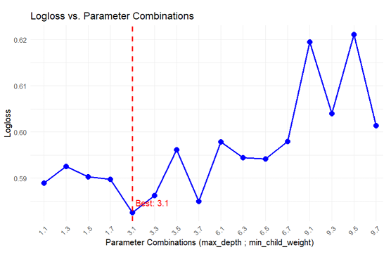
APPLICATION OF M.L. ALGORITHMS
Step-wise tuning strategy
Start the initial default values
Number of boosting rounds
Max tree depth ; Min child weight
Gamma
Subsample ; Colsample by tree
Lambda ; Alpha
To ensure robust results and prevent overfitting, we employed a 5-fold cross validation at each step.
At each step, we store the best values and use them for further tuning in the next step…
7. Learning rate (eta)
max_tree_depth = 3
min_child_weight = 1
8. Max delta step

Slide 69
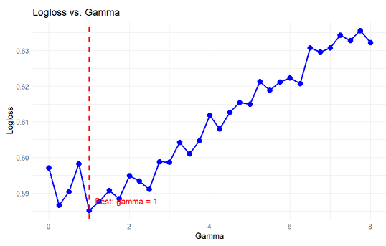
APPLICATION OF M.L. ALGORITHMS
Step-wise tuning strategy
Start the initial default values
Number of boosting rounds
Max tree depth ; Min child weight
Gamma
Subsample ; Colsample by tree
Lambda ; Alpha
To ensure robust results and prevent overfitting, we employed a 5-fold cross validation at each step.
Gamma = 1
7. Learning rate (eta)
max_tree_depth = 3
min_child_weight = 1
8. Max delta step

Slide 70
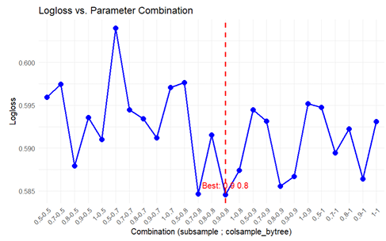
APPLICATION OF M.L. ALGORITHMS
Step-wise tuning strategy
Start the initial default values
Number of boosting rounds
Max tree depth ; Min child weight
Gamma
Subsample ; Colsample by tree
Lambda ; Alpha
To ensure robust results and prevent overfitting, we employed a 5-fold cross validation at each step.
Subsample = 0.9
Colsample by tree = 1
7. Learning rate (eta)
Gamma = 1
8. Max delta step

Slide 71
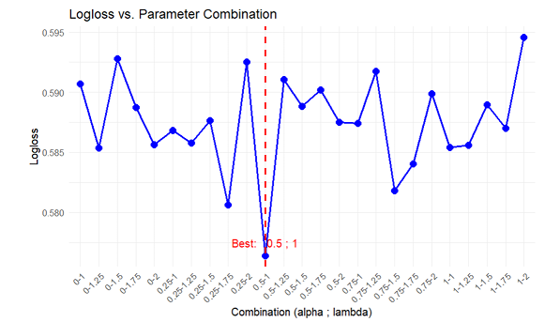
APPLICATION OF M.L. ALGORITHMS
Stepwise tuning procedure
This python script serves as a centralized configuration file, containing essential variables and settings that control the behavior of the application. Here's an explanation of its components:
Update the initial default values with:
Subsample = 0.9
Colsample by tree = 1
# settings for developers
ANONYMIZED = True
DEBUG = False
DISABLE_LOGIN = True
# Credentials for accessing the SQL database
SERVER_SSMS =
DRIVER_SSMS =
DATABASE_SSMS =
UID_SSMS =
PSW_SSMS =
Alpha = 0.5
Lambda = 1

Slide 72
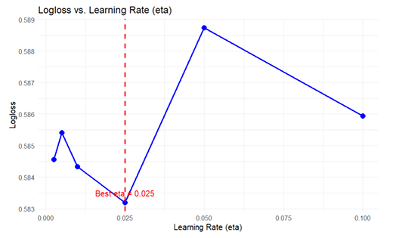
APPLICATION OF M.L. ALGORITHMS
Stepwise tuning procedure
This python script serves as a centralized configuration file, containing essential variables and settings that control the behavior of the application. Here's an explanation of its components:
Learning rate (eta) = 0.025
# settings for developers
ANONYMIZED = True
DEBUG = False
DISABLE_LOGIN = True
# Credentials for accessing the SQL database
SERVER_SSMS =
DRIVER_SSMS =
DATABASE_SSMS =
UID_SSMS =
PSW_SSMS =
Alpha = 0.5
Lambda = 1

Slide 73
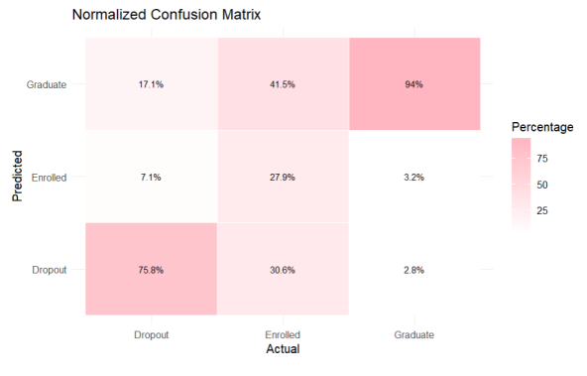
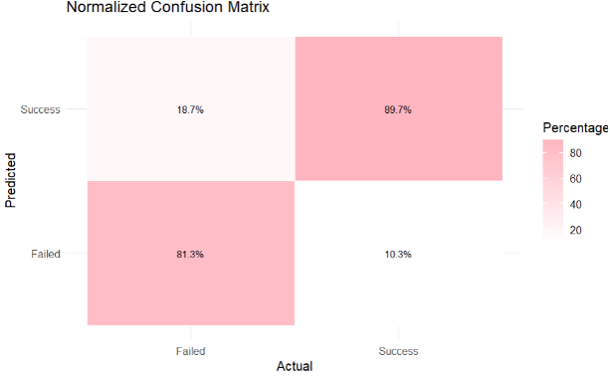
APPLICATION OF M.L. ALGORITHMS
XGBoost Prediction Performance
Three-class analysis
Two-class analysis

Slide 74

APPLICATION OF M.L. ALGORITHMS
XGBoost predictions in 3-class analysis
The model is highly reliable when it comes to predicting the “Graduate” class.
It correctly classifies 94% of the “Graduate” cases and only misclassifies 3.2% and 2.8% of “Graduate” students, respectively, as “Enrolled” and “Dropout”.

Slide 75
APPLICATION OF M.L. ALGORITHMS
XGBoost predictions in 3-class analysis
This python script serves as a centralized configuration file, containing essential variables and settings that control the behavior of the application. Here's an explanation of its components:
The “Enrolled” class is often confused with the extreme classes (“Graduate” and “Dropout”).
The model misclassifies 41.5% of “Enrolled” students as“Graduates”, 30% as “Dropout” and only 28% of the times it predict the correct class “Enrolled”.
# settings for developers
ANONYMIZED = True
DEBUG = False
DISABLE_LOGIN = True
# Credentials for accessing the SQL database
SERVER_SSMS =
DRIVER_SSMS =
DATABASE_SSMS =
UID_SSMS =
PSW_SSMS =
This is likely because the data associated with “Enrolled” students can resemble characteristics of both “Graduate” and “Dropout” students. As a transitional or “limbo” class it is naturally harder to define, making it more susceptible to misclassification when compared to the more distinct “Graduate” and “Dropout” classes.

Slide 76
APPLICATION OF M.L. ALGORITHMS
XGBoost predictions in 3-class analysis
This python script serves as a centralized configuration file, containing essential variables and settings that control the behavior of the application. Here's an explanation of its components:
Regarding the “Dropout” class the model achieves good performance by correctly classifying almost 76% of the students in that class.
The main issue is that 17% of the time the model misclassifies a student by predicting “Graduate” instead when the student is “Dropout”. This result is somewhat unexpected, as the model is confusing the two most extreme classes.
# settings for developers
ANONYMIZED = True
DEBUG = False
DISABLE_LOGIN = True
# Credentials for accessing the SQL database
SERVER_SSMS =
DRIVER_SSMS =
DATABASE_SSMS =
UID_SSMS =
PSW_SSMS =

Slide 77
APPLICATION OF M.L. ALGORITHMS
XGBoost predictions in 2-class analysis
This python script serves as a centralized configuration file, containing essential variables and settings that control the behavior of the application. Here's an explanation of its components:
The model XGBoost in this binary framework performs extremely well in predicting the “Success” cases.
Regarding the “Success” class it correctly classifies 90% of the cases and makes a mistake only 10% of the times!
# settings for developers
ANONYMIZED = True
DEBUG = False
DISABLE_LOGIN = True
# Credentials for accessing the SQL database
SERVER_SSMS =
DRIVER_SSMS =
DATABASE_SSMS =
UID_SSMS =
PSW_SSMS =

Slide 78
APPLICATION OF M.L. ALGORITHMS
XGBoost predictions in 2-class analysis
This python script serves as a centralized configuration file, containing essential variables and settings that control the behavior of the application. Here's an explanation of its components:
The challenge in this binary framework lies in correctly identifying the positive class “Failed”.
18.7% of the times, the model makes an error by predicting a success case when the student has actually failed, resulting in false negatives.
# settings for developers
ANONYMIZED = True
DEBUG = False
DISABLE_LOGIN = True
# Credentials for accessing the SQL database
SERVER_SSMS =
DRIVER_SSMS =
DATABASE_SSMS =
UID_SSMS =
PSW_SSMS =

Slide 79
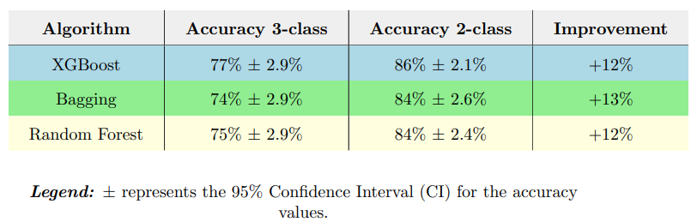
APPLICATION OF M.L. ALGORITHMS
Summary of Predictions in 2-Class and 3-Class analyses
This python script serves as a centralized configuration file, containing essential variables and settings that control the behavior of the application. Here's an explanation of its components:
# settings for developers
ANONYMIZED = True
DEBUG = False
DISABLE_LOGIN = True
# Credentials for accessing the SQL database
SERVER_SSMS =
DRIVER_SSMS =
DATABASE_SSMS =
UID_SSMS =
PSW_SSMS =

Slide 80
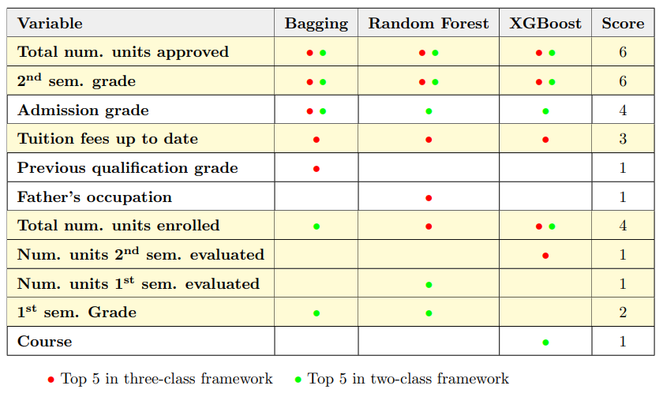
APPLICATION OF M.L. ALGORITHMS
Variable Importance
This python script serves as a centralized configuration file, containing essential variables and settings that control the behavior of the application. Here's an explanation of its components:
The best-performing variables, used in all frameworks and algorithms, are the total number of approved units and the second semester grade.
7 of these 11 variables are related to student’s performance after starting university.
# settings for developers
ANONYMIZED = True
DEBUG = False
DISABLE_LOGIN = True
# Credentials for accessing the SQL database
SERVER_SSMS =
DRIVER_SSMS =
DATABASE_SSMS =
UID_SSMS =
PSW_SSMS =
variables related to students’ performance during their first year are necessary to build a reliable model.

Slide 81
APPLICATION OF M.L. ALGORITHMS
«Pre-Enrollment» analysis
Prediction Performance
Variable Importance

Slide 82
APPLICATION OF M.L. ALGORITHMS
«Pre-Enrollment» analysis
Prediction Performance
Variable Importance
“Pre-Enrollment” analysis allows to address potential issues related to university dropout before students even begin their academic journey.
Thus, we are able to understand in early stage which factors contribute to dropout, enabling the creation of targeted support programs to assist students from the beginning of their university studies.

Slide 83
APPLICATION OF M.L. ALGORITHMS
«Pre-Enrollment» analysis
“Pre-Enrollment” analysis allows to address potential issues related to university dropout before students even begin their academic journey.
Thus, we are able to understand in early stage which factors contribute to dropout, enabling the creation of targeted support programs to assist students from the beginning of their university studies.
Variable Importance
Prediction Performance

Slide 84

DATASET AND PREPROCESSING
dataset
“Pre-Enrollment” Features
Gender
Nationality
4. Debtor
Age at enrollment
5. Tuition fees up-to-date
Demografic
6. Scholarship holder
7. Displaced
Socio-economic status
8. Father’s qualification
9. Mother’s qualification
Family background
10. Father’s occupation
11. Mother’s qualification
Academic performance
15. Course
Academic pathway
16. Attendance
Regional Macroeconomic context

Slide 85
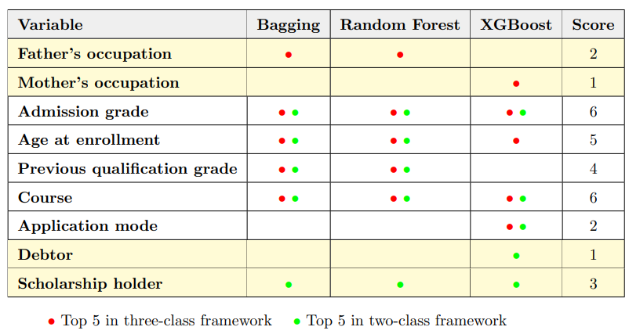
APPLICATION OF M.L. ALGORITHMS
«Pre-Enrollment» Variable Importance
This python script serves as a centralized configuration file, containing essential variables and settings that control the behavior of the application. Here's an explanation of its components:
# settings for developers
ANONYMIZED = True
DEBUG = False
DISABLE_LOGIN = True
# Credentials for accessing the SQL database
SERVER_SSMS =
DRIVER_SSMS =
DATABASE_SSMS =
UID_SSMS =
PSW_SSMS =

Slide 86
APPLICATION OF M.L. ALGORITHMS
«Pre-Enrollment» Variable Importance
This python script serves as a centralized configuration file, containing essential variables and settings that control the behavior of the application. Here's an explanation of its components:
Father’s occupation
Mother’s occupation
Debtor
Scholarship holder
We observe that the two variables with the highest scores are “Admission Grade” and “Course” chosen by the students, both of which consistently appear in the top 5 in all cases.
Four of these nine variables, are directly related to a student’s economic situation.
# settings for developers
ANONYMIZED = True
DEBUG = False
DISABLE_LOGIN = True
# Credentials for accessing the SQL database
SERVER_SSMS =
DRIVER_SSMS =
DATABASE_SSMS =
UID_SSMS =
PSW_SSMS =

Slide 87


APPLICATION OF M.L. ALGORITHMS
«Pre-Enrollment» Variable Importance
Father’s occupation
Mother’s occupation
Debtor
Scholarship holder
This factor is reflecting whether a student has more or fewer financial resources and seem to be critical in determining the academic performances of the students.
In this analysis students’ performance is measured by 3 key variables:
“Financial variable”

Slide 88
APPLICATION OF M.L. ALGORITHMS
«Pre-Enrollment» Variable Importance
Father’s occupation
Mother’s occupation
Debtor
Scholarship holder
“Financial variable”
This variable is reflecting whether a student has more or fewer financial resources and seem to be critical in determining the academic performances of the students.

Slide 89
APPLICATION OF M.L. ALGORITHMS
«Pre-Enrollment» Variable Importance
Father’s occupation
Mother’s occupation
Debtor
Scholarship holder
“Financial variable”
This variable is reflecting whether a student has more or fewer financial resources and seem to be critical in determining the academic performances of the students.
With this factor in mind, we proceed with our analysis…

Slide 90
APPLICATION OF M.L. ALGORITHMS
«Pre-Enrollment» Variable Importance
Father’s occupation
Mother’s occupation
Debtor
Scholarship holder
“Financial variable”
This variable is reflecting whether a student has more or fewer financial resources and seem to be critical in determining the academic performances of the students.
With this factor in mind, we proceed with our analysis…

Slide 91


APPLICATION OF M.L. ALGORITHMS
«Pre-Enrollment» Variable Importance
This python script serves as a centralized configuration file, containing essential variables and settings that control the behavior of the application. Here's an explanation of its components:
Step: we filter the dataset based of parent’s occupation, and try to create two groups:
Managers
Ingeneers
Architects
Health professionals
Legislators
Lawers
teachers
High-Qualified Families: Includes students whose families have at least one parent engaged in a qualified work.
# settings for developers
ANONYMIZED = True
DEBUG = False
DISABLE_LOGIN = True
# Credentials for accessing the SQL database
SERVER_SSMS =
DRIVER_SSMS =
DATABASE_SSMS =
UID_SSMS =
PSW_SSMS =
And associated with above-average salaries, making the family wealthier in terms of financial resources.
All these jobs share the fact that they require a university degree or a master's qualification

Slide 92
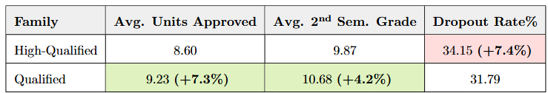
APPLICATION OF M.L. ALGORITHMS
«Pre-Enrollment» Variable Importance
This python script serves as a centralized configuration file, containing essential variables and settings that control the behavior of the application. Here's an explanation of its components:
Step: we filter the dataset based of parent’s occupation, and try to create two groups:
Protection and security services personnel
Sellers
Farmers, livestock keepers, fishermen, hunters
Workers in food processing, woodworking, clothing and other industries and crafts
Construction workers
Metallurgy workers
High-Qualified Families.
Qualified Families: includes students whose families have neither parent engaged in a qualified work.
# settings for developers
ANONYMIZED = True
DEBUG = False
DISABLE_LOGIN = True
# Credentials for accessing the SQL database
SERVER_SSMS =
DRIVER_SSMS =
DATABASE_SSMS =
UID_SSMS =
PSW_SSMS =
often less paid compared to the jobs in qualified families
All these jobs share the fact that they do not require a university degree or a master's qualification

Slide 93
APPLICATION OF M.L. ALGORITHMS
«Pre-Enrollment» Variable Importance
Step: we filter the dataset based of parent’s occupation, and try to create two groups:
High-Qualified Families.
Qualified Families.
2. Step: Try to seen if the family background has a positive or negative impact on students’ performance:

Slide 94

APPLICATION OF M.L. ALGORITHMS
«Pre-Enrollment» Variable Importance
Surprisingly, if we consider only parental occupation, students from Qualified families outperform those from High-Qualified families, based on parental occupation groups.
But what is happening if we also consider the other financial variables ?
They have a strong motivation to complete their university education because for them it serves as a critical pathway for social mobility offering the opportunity to improve their economic status and achieve professional success.

Slide 95



APPLICATION OF M.L. ALGORITHMS
«Pre-Enrollment» Variable Importance
2. Step: We found that parental occupation do not negatively impact the academic performance of students from unqualified families.
But what is happening if we also consider the other financial variables ?
Debt
Scholarship holder

Slide 96
APPLICATION OF M.L. ALGORITHMS
«Pre-Enrollment» Variable Importance
2. Step: We found that parental occupation do not negatively impact the academic performance of students from unqualified families.
But what is happening if we also consider the other financial variables ?
Debt
Scholarship holder

Slide 97



APPLICATION OF M.L. ALGORITHMS
«Pre-Enrollment» Variable Importance
3. Step: further filter the dataset considering the variables Debtor and Scholarship holder.
Non-Wealthy Families
Wealthy Families
Unqualified work
Debt
No scholarship
High-qualified work
No Debt

Slide 98
APPLICATION OF M.L. ALGORITHMS
«Pre-Enrollment» Variable Importance
3. Step: further filter the dataset considering the variables Debtor and Scholarship holder.
Wealthy Families
Non-Wealthy Families
High-qualified work
No Debt

Slide 99
APPLICATION OF M.L. ALGORITHMS
«Pre-Enrollment» Variable Importance
3. Step: further filter the dataset considering the variables Debtor and Scholarship holder.
Wealthy Families
Non-Wealthy Families
High-qualified work
No Debt

Slide 100
APPLICATION OF M.L. ALGORITHMS
«Pre-Enrollment» Variable Importance
3. Step: further filter the dataset considering the variables Debtor and Scholarship holder.
Wealthy Families
Non-Wealthy Families
High-qualified work
No Debt
Qualified work

Slide 101
APPLICATION OF M.L. ALGORITHMS
«Pre-Enrollment» Variable Importance
3. Step: further filter the dataset considering the variables Debtor and Scholarship holder.
Wealthy Families
Non-Wealthy Families
Qualified work
Qualified work
No Debt
Debt

Slide 102
APPLICATION OF M.L. ALGORITHMS
«Pre-Enrollment» Variable Importance
3. Step: further filter the dataset considering the variables Debtor and Scholarship holder.
Wealthy Families
Non-Wealthy Families
Qualified work
Qualified work
No Debt
Debt
No scholarship

Slide 103

APPLICATION OF M.L. ALGORITHMS
«Pre-Enrollment» Variable Importance
3. Step: further filter the dataset considering the variables Debtor and Scholarship holder.
Wealthy Families
Non-Wealthy Families
Qualified work
Unqualified work
No Debt
Debt
No scholarship

Slide 104

APPLICATION OF M.L. ALGORITHMS
«Pre-Enrollment» Variable Importance
After grouping student’s in to:
Wealthy Families
Non-Wealthy Families
1. Total number of curricular units approved

Slide 105
APPLICATION OF M.L. ALGORITHMS
«Pre-Enrollment» Variable Importance
After grouping student’s in to:
Wealthy Families
Non-Wealthy Families
1. Total number of curricular units approved
2. Second semester grade

Slide 106
APPLICATION OF M.L. ALGORITHMS
«Pre-Enrollment» Variable Importance
After grouping student’s in to:
Wealthy Families
Non-Wealthy Families
1. Total number of curricular units approved
2. Second semester grade
3. Dropout rate

Slide 107
APPLICATION OF M.L. ALGORITHMS
«Pre-Enrollment» Variable Importance
After grouping student’s in to:
Wealthy Families
Non-Wealthy Families
1. Total number of curricular units approved
2. Second semester grade
3. Dropout rate

Slide 108
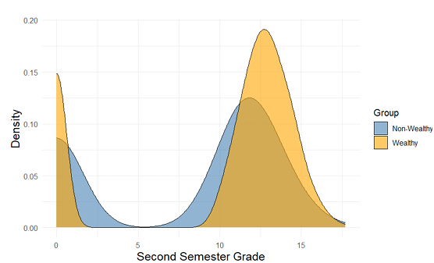
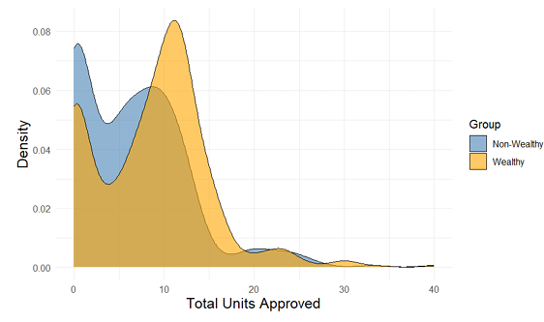
APPLICATION OF M.L. ALGORITHMS
Non-Wealthy Families
«Pre-Enrollment» Variable Importance
SECOND SEMESTER GRADE DISTRIBUTION
Students from wealthy families have an average second-semester grade that is 28% higher compared to students from non-wealthy families.

Slide 109
APPLICATION OF M.L. ALGORITHMS
Non-Wealthy Families
«Pre-Enrollment» Variable Importance
SECOND SEMESTER GRADE DISTRIBUTION
Students from wealthy families have an average second-semester grade that is 28% higher compared to students from non-wealthy families.

Slide 110
APPLICATION OF M.L. ALGORITHMS
Non-Wealthy Families
«Pre-Enrollment» Variable Importance
TOTAL NUMBER OF CURRICULAR UNITS APPROVED DISTRIBUTION
The average number of approved units for students from wealthy families is 34% higher compared to students from non-wealthy families.

Slide 111
APPLICATION OF M.L. ALGORITHMS
«Pre-Enrollment» Variable Importance
TOTAL NUMBER OF CURRICULAR UNITS APPROVED DISTRIBUTION
The average number of approved units for students from wealthy families is 34% higher compared to students from non-wealthy families.

Slide 112

APPLICATION OF M.L. ALGORITHMS
«Pre-Enrollment» Variable Importance
DROPOUT RATE
Pre-enrollment
First year of university
31%
Wealthy Families
Non-Wealthy Families
68%

Slide 113
APPLICATION OF M.L. ALGORITHMS
«Pre-Enrollment» Variable Importance
DROPOUT RATE
Pre-enrollment
First year of university
Wealthy Families
31%
Non-Wealthy Families
68%

Slide 114

APPLICATION OF M.L. ALGORITHMS
«Pre-Enrollment» Variable Importance
DROPOUT RATE
Pre-enrollment
First year of university
What happens to students in this group once they start university?
Wealthy Families
Non-Wealthy Families
68%
31%

Slide 115

APPLICATION OF M.L. ALGORITHMS
«Pre-Enrollment» Variable Importance
DROPOUT RATE
Pre-enrollment
First year of university
Dropout rates are notably higher among students from unqualified families (economically disadvantaged backgrounds) who had to take on debt to afford university education, particularly those who also lacked scholarships
Wealthy Families
31%
Non-Wealthy Families
68%

Slide 116

APPLICATION OF M.L. ALGORITHMS
«Pre-Enrollment» Variable Importance
DROPOUT RATE
Pre-enrollment
First year of university
Wealthy Families
Great Financial Pressure
31%
Non-Wealthy Families
68%

Slide 117

APPLICATION OF M.L. ALGORITHMS
«Pre-Enrollment» Variable Importance
DROPOUT RATE
Pre-enrollment
First year of university
Great Financial Pressure
54% probability of falling behind on tuition fees

Slide 118


APPLICATION OF M.L. ALGORITHMS
«Pre-Enrollment» Variable Importance
DROPOUT RATE
Pre-enrollment
First year of university
Should I continue my studies ?

Slide 119
APPLICATION OF M.L. ALGORITHMS
«Pre-Enrollment» Variable Importance
DROPOUT RATE
Pre-enrollment
First year of university
Should I continue my studies ?
Go working and earn immediately some money ?

Slide 120
APPLICATION OF M.L. ALGORITHMS
«Pre-Enrollment» Variable Importance
DROPOUT RATE
Pre-enrollment
First year of university
Should I continue my studies ?
90% probability of dropping out of university at this stage
Go working and earn immediately some money ?

Slide 121
APPLICATION OF M.L. ALGORITHMS
Should I continue my studies ?
«Pre-Enrollment» Variable Importance
DROPOUT RATE
Pre-enrollment
First year of university
90% probability of dropping out of university at this stage
This means that if a student is in such a dramatic situation, there is no realistic chance of overcoming it
Go working and earn immediately some money ?

Slide 122
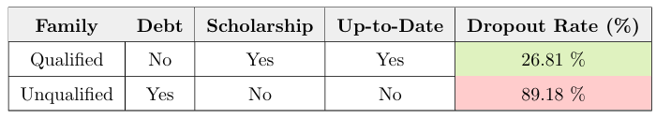

APPLICATION OF M.L. ALGORITHMS
Should I continue my studies ?
«Pre-Enrollment» Variable Importance
DROPOUT RATE
Pre-enrollment
First year of university
90% probability of dropping out of university at this stage
This means that if a student is in such a dramatic situation, there is no realistic chance of overcoming it
Go working and earn immediately some money ?

Slide 123
APPLICATION OF M.L. ALGORITHMS
«Pre-Enrollment» Variable Importance
DROPOUT RATE
Pre-enrollment
First year of university
The following table summarizes the entire analysis
Until now we saw that student’s financial status plays a significant role in the likelihood of success at university

Slide 124

CONCLUSION
A Matter of Luck!
Our main finding was that student’s financial status plays a significant role in the likelihood of success at university.
THANK YOU FOR
YOUR ATTENTION
Financial status is out of a student’s control: is a matter of luck!
If such a decisive factor for academic success is primarily determined by luck, it raises many questions about the concept of meritocracy in higher education.
Educational Data Mining (EDM ) can help to change the game by creating early stage support programs for everybody in order to allow less lucky students to improve significantly their performances and making meritocracy real!

Slide 125



THANK YOU FOR
YOUR ATTENTION
UI customization: Streamlit’s limited flexibility for complex layouts or customized components.
Documentation: Tutorials and guides could ease user onboarding and understanding.
User training: Initial training needed for non-technical users to utilize advanced functionalities.

Slide 126
DATASET AND PREPROCESSING
dataset
Features overview
Gender
Nationality
Age at enrollment
4. Debtor
Demografic
5. Tuition fees up-to-date
6. Scholarship holder
Socio-economic status
7. Displaced
8. Father’s qualification
9. Mother’s qualification
Family background
10. Father’s occupation
11. First semester grade
12. Total number of curr. units approved
13. Total number of curr. units enrolled
Academic performance
14. Second semester grade
15. Course
Academic pathway
16. Attendance
17. Application mode
18. Unemployment rate
19. Inflation rate
Regional Macroeconomic context
20. GDP

